Slide 1
Medical Rights and Tissue Ownership
Notes:
Research examples presented in this powerpoint are from:
Petrini, C. (2012). Ethical and legal considerations regarding the ownership and commercial use of human biological materials and their derivatives. Journal of Blood Medicine, 3, 87–96. https://doi.org/10.2147/jbm.s36134

Slide 2
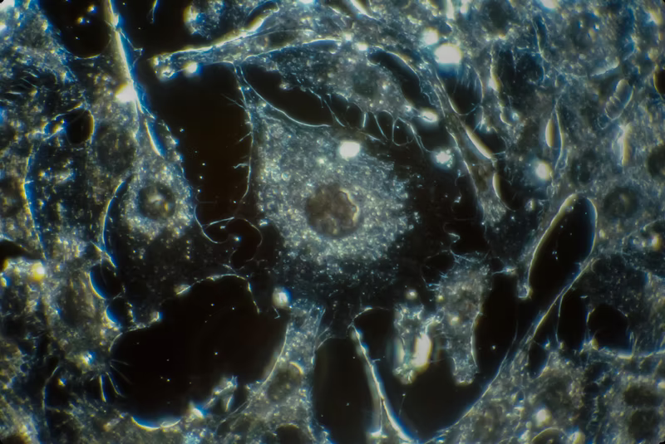
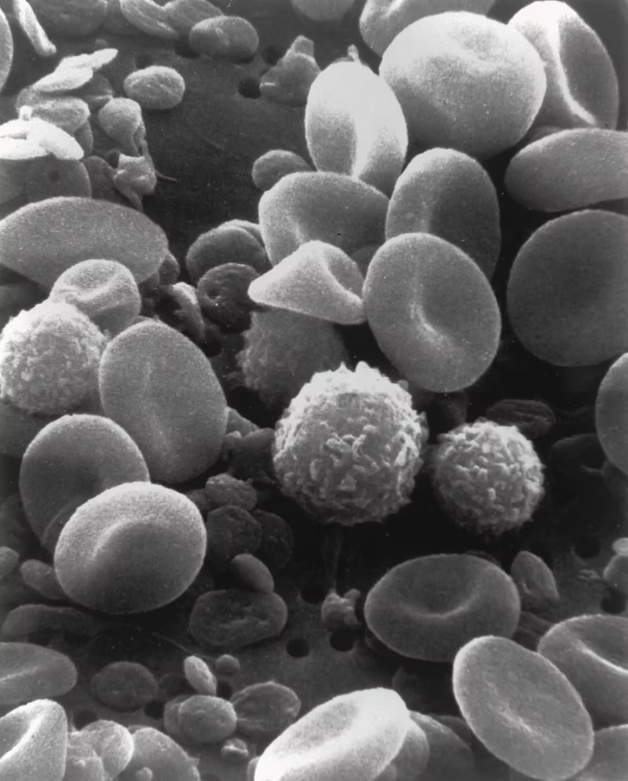
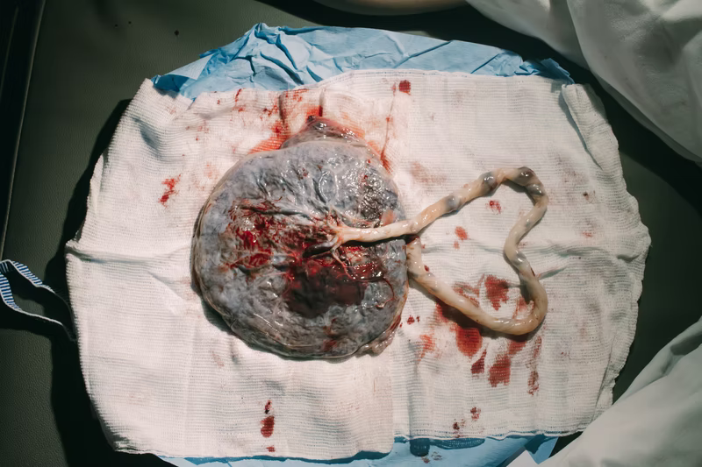
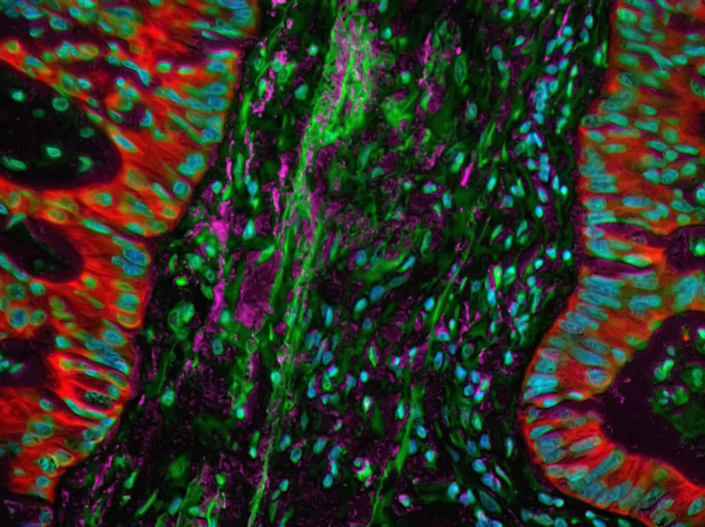
Biological Sample Collection
Purposes
Diagnosis or treatment (clinical)
Altruistic donation for therapeutic purposes (e.g. blood donation)
Research donations
Laws Currently Under Consideration
Much more complicated!
Blood and organ donation; storage of reproductive tissues
Petrini (2012). Journal of Blood Medicine.
Notes:
Some are much more complicated than others!
Ex: Blood and plasma, umbilical cord samples

Slide 3
Informed Consent
Informed consent includes:
Description of Research
Risks and Discomforts
Benefits
Alternative Procedures or Treatments
Confidentiality
Compensation and Treatment in case of Injury
Voluntary Participation
Cannot include exculpatory language:
I waive any possibility of compensation, including any right to sue, for injuries that I may receive as a result of participation in this research.
If you suffer a research-related injury, neither the institution nor the investigator can assume financial responsibility or liability for the expenses of treatment for such injury.
In the event that you suffer a research-related injury, your medical expenses will be your responsibility or that of your third party payer.
- Department of Health and Human Services
Notes:
Goes far beyond obtaining a signature on a consent form
Poorly conducted informed consent has led to many of the cases we will discuss today
The informed consent process involves three key features:
(1) disclosing to potential research subjects information needed to make an informed decision;
(2) facilitating the understanding of what has been disclosed; and
(3) promoting the voluntariness of the decision about whether or not to participate in the research. Informed consent must be legally effective and prospectively obtained
-Department of Health and Human Services
Informed consent includes:
Description of Research
Risks and Discomforts
Benefits
Alternative Procedures or Treatments
Confidentiality
Compensation and Treatment in case of Injury
Voluntary Participation
Cannot include exculpatory language:
I waive any possibility of compensation, including any right to sue, for injuries that I may receive as a result of participation in this research.
If you suffer a research-related injury, neither the institution nor the investigator can assume financial responsibility or liability for the expenses of treatment for such injury.
In the event that you suffer a research-related injury, your medical expenses will be your responsibility or that of your third party payer.

Slide 4
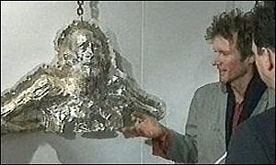
Who owns your body?
There are a number of ethical and legal considerations to take into account
Is the person deceased?
"There can be no property of a corpse"- Common Law until 1908
Doodeward v Spence in 1908 (Australia)
Artist Anthony-Noel Kelly in 1998 (England)
The answer is more complicated than it sounds, is highly debated, and depends on the circumstances
Petrini (2012). Journal of Blood Medicine.
Notes:
There are a number of ethical and legal considerations to take into account
Is the person decreased?
"There can be no property of a corpse"- Common Law until 1908
Doodeward v Spence in 1908 (Australia)- Doodeward purchased a preserved two-headed fetus for display and it was ruled that it was not a mere corpse awaiting burial, but that the body had "skilled-work" invested, and he was therefore allowed to own it.
Artist Anthony-Noel Kelly stole preserved body parts for use as molds for sculptures in 1998 (England). Because surgeons had invested "skilled-work" into collecting the parts, he was arrested and served 9-months in prison
The answer is more complicated than it sounds, is highly debated, and depends on the circumstances

Slide 5
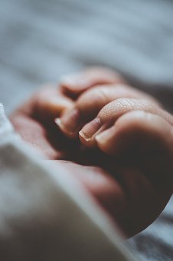
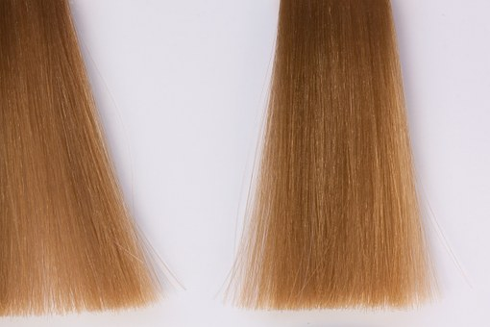
Who owns your body?
Convention for the Protection of Human Rights and Dignity of the Human Being with Regard to the Application of Biology and Medicine: Convention on Human Rights and Biomedicine -
Article 21
Protected Tissues
Donor =
"Every human source, whether living or deceased, of human cells or tissues".
Not Protected Tissues
Petrini (2012). Journal of Blood Medicine.
Notes:
“The human body and its parts shall not, as such, give rise to financial gain.” Article 22, under the heading “Disposal of a removed part of the human body,” dictates that: When in the course of an intervention any part of a human body is removed, it may be stored and used for a purpose other than that for which it was removed, only if this is done in conformity with appropriate information and consent procedures.41 The Explanatory Report44 to the Convention clarifies the meaning of “body parts,” which includes “organs and tissues proper, including blood,” but excludes “hair and nails, which are discarded tissues, and the sale of which is not an affront to human dignity.
Other entities followed suit:
United States -
Universal Declaration on the Human Genome and Human Rights, the International Declaration on Human Genetic Data and the Universal Declaration on Bioethics and Human Rights

Slide 6
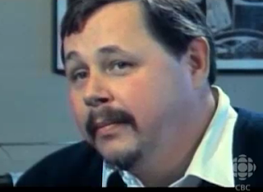
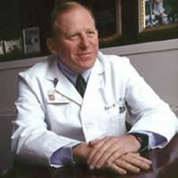
Significant Examples
Moore vs. The University of California
John Moore splenectomy in 1976 at UCLA
Was asked back from multiple blood samples
1983: Asked to sign informed consent to use his samples for research purposes
1984-1990: Used blood to develop cell line "Moore's T-lymphocytes" and got patent which earned more than 3 billion dollars
Moore sued, and his claim was rejected at the Supreme Court
John Moore
Dr. David Golde
Notes:
Moore vs. The University of California
John Moore splenectomy in 1976 at UCLA
Was asked back from multiple blood samples
1983: Asked to sign informed consent to use his samples for research purposes
1984-1990: Used blood to develop cell line "Moore's T-lymphocytes" and got patent which earned more than 3 billion dollars
Moore sued, and his claim was rejected at the Supreme Court
Lack of precedent
CA laws on disposal of human tissues
Patented cells were altered after being taken from him, and were no longer considered his property
For more information, students can watch:
CBC The Nature of Things (Director). (2007). The Man With The Golden Cells [Motion Picture].

Slide 7
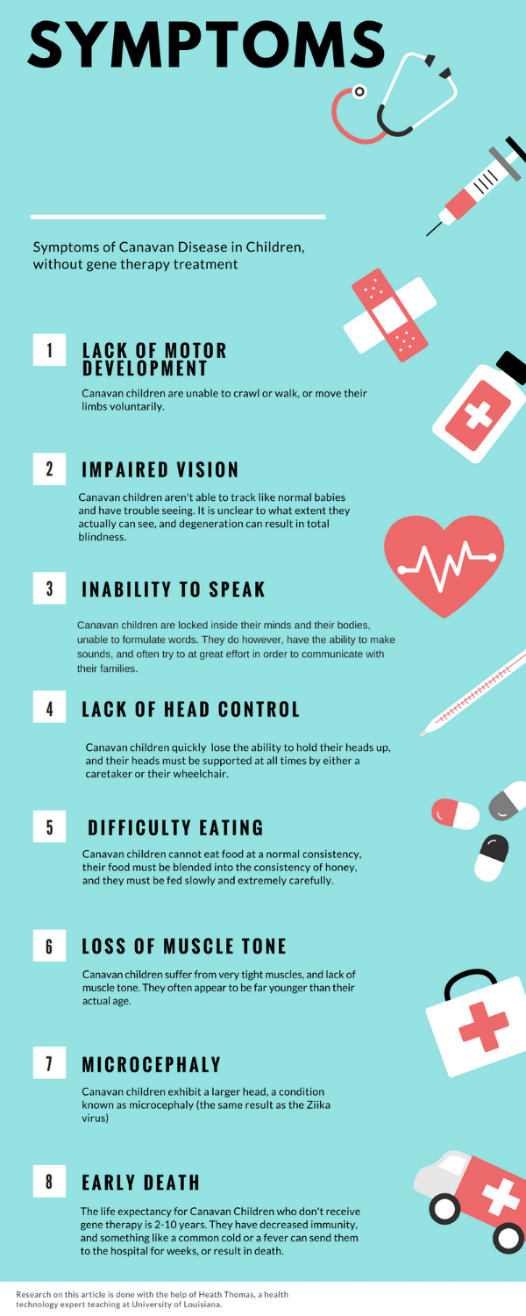
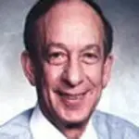
Significant Examples
Greenberg vs. Miami Children's Hospital Research Institute
Dr. Rueben Matalon was trying to develop a pre-natal test for Canavan Disease
Daniel Greenberg gave blood, urine, and tissue samples
Pre-natal test was successfully developed, and Matalon patented a cloned gene resulting from the research
Greenberg and other donors sued in 2002 claiming they were unaware of how the samples would be used for commercial purposes
Judge ruled that researchers must obtain consent and provide ample information, but are not required to provide information extending to economic interests
Since, a code has been declared in the "Code of Medical Ethics" stating that economic interests should be declared
Image from:
Canavan.org
Notes:
Greenberg vs. Miami Children's Hospital Research Institute
Dr. Rueben Matalon was trying to develop a pre-natal test for Canavan Disease
Daniel Greenberg gave blood, urine, and tissue samples
Pre-natal test was successfully developed, and Matalon patented a cloned gene resulting from the research
Patent makes ~350K dollars a year in profit
Greenberg and other donors sued in 2002 claiming they were unaware of how the samples would be used for commercial purposes
Judge ruled that researchers must obtain consent and provide ample information, but are not required to provide information extending to economic interests
Produces of research are factually and legally distinct from the original tissue and are the property of the researcher, not the donor
Since, a code has been declared in the "Code of Medical Ethics" stating that economic interests should be declared

Slide 8
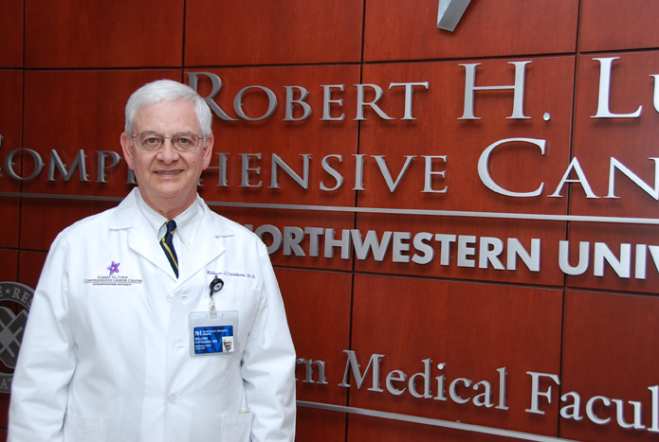
Significant Examples
Washington University vs. Catalona
William Catalona collected tissues and biological materials during prostate surgery
Consent acknowledged "Free and Generous Gift"
Washington University collected ~30,000 samples, ~3,000 of which came from Catalona
Catalona tried to transferr a large number of samples to a new university (Northwestern
Asked patient authorization to take their samples with him
WU would not release the samples, and sued Catalona for samples they said they owned
Patients became involved, saying that they gave their samples to Catalona, and did not donate for WU to make a profit
Eighth Circuit Court of Appeals
Patients made a donation and have no rights to the materials or the right to order it transferred
Petrini (2012). Journal of Blood Medicine.
Notes:
Washington University vs. Catalona
William Catalona received consent from many patients to collect tissues and biological materials during prostate surgery
Consent acknowledged "Free and Generous Gift"
Washington University collected ~30,000 samples, ~3,000 of which came from Catalona
Catalona transferred a large number of samples to a private laboratory
University objected, saying he had taken ~100K dollars worth of samples and Catalona moved to Northwestern School of Medicine
Asked patient authorization to take their samples with him
WU would not release the samples, and sued Catalona for samples they said they owned
Patients became involved, saying that they gave their samples to Catalona, and did not donate for WU to make a profit
Eighth Circuit Court of Appeals
Patients made a donation and have no rights to the materials or the right to order it transferred

Slide 9
From these cases, the general rule is.....
donors of biological material have a right to be informed of its possible uses and, in particular, of potential commercial spin-offs;
the right to control the biological material taken from a donor ceases at the moment of donation;
donors cannot claim rights of “ownership” in biological material; and
the recipient has the right to commercial exploitation of any products developed from the processing of biological material received, in accordance with current legislation.
Petrini (2012). Journal of Blood Medicine.
Notes:
donors of biological material have a right to be informed of its possible uses and, in particular, of potential commercial spin-offs;
the right to control the biological material taken from a donor ceases at the moment of donation;
donors cannot claim rights of “ownership” in biological material; and
the recipient has the right to commercial exploitation of any products developed from the processing of biological material received, in accordance with current legislation.

Slide 10
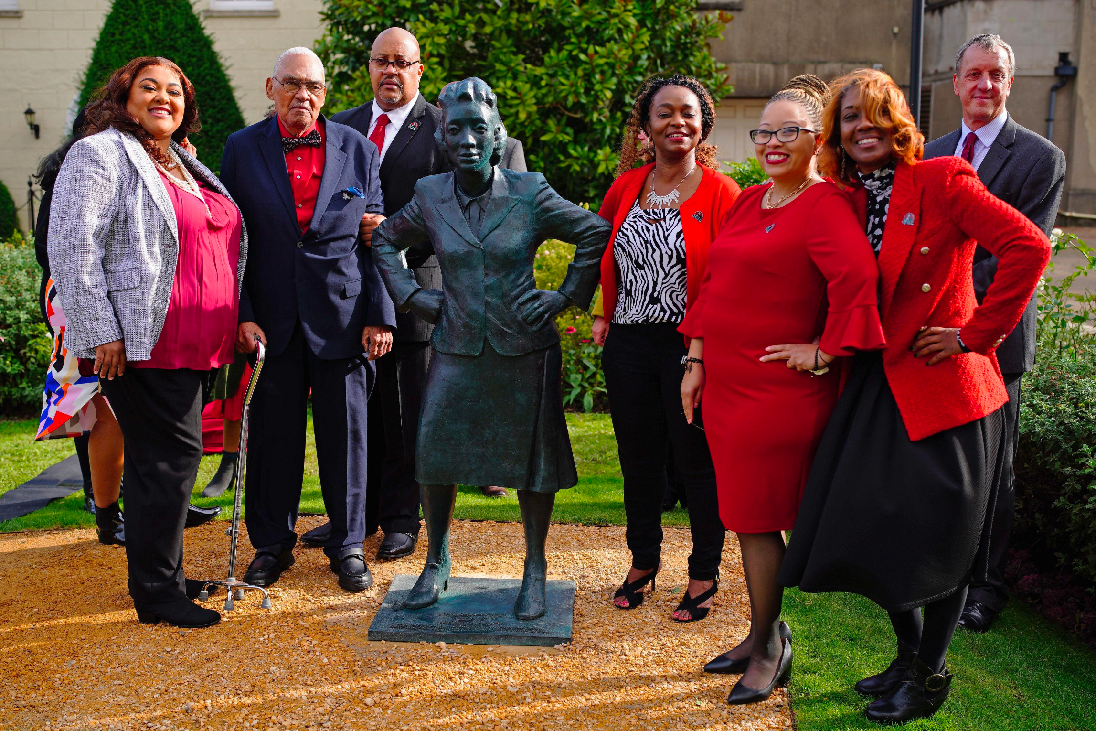
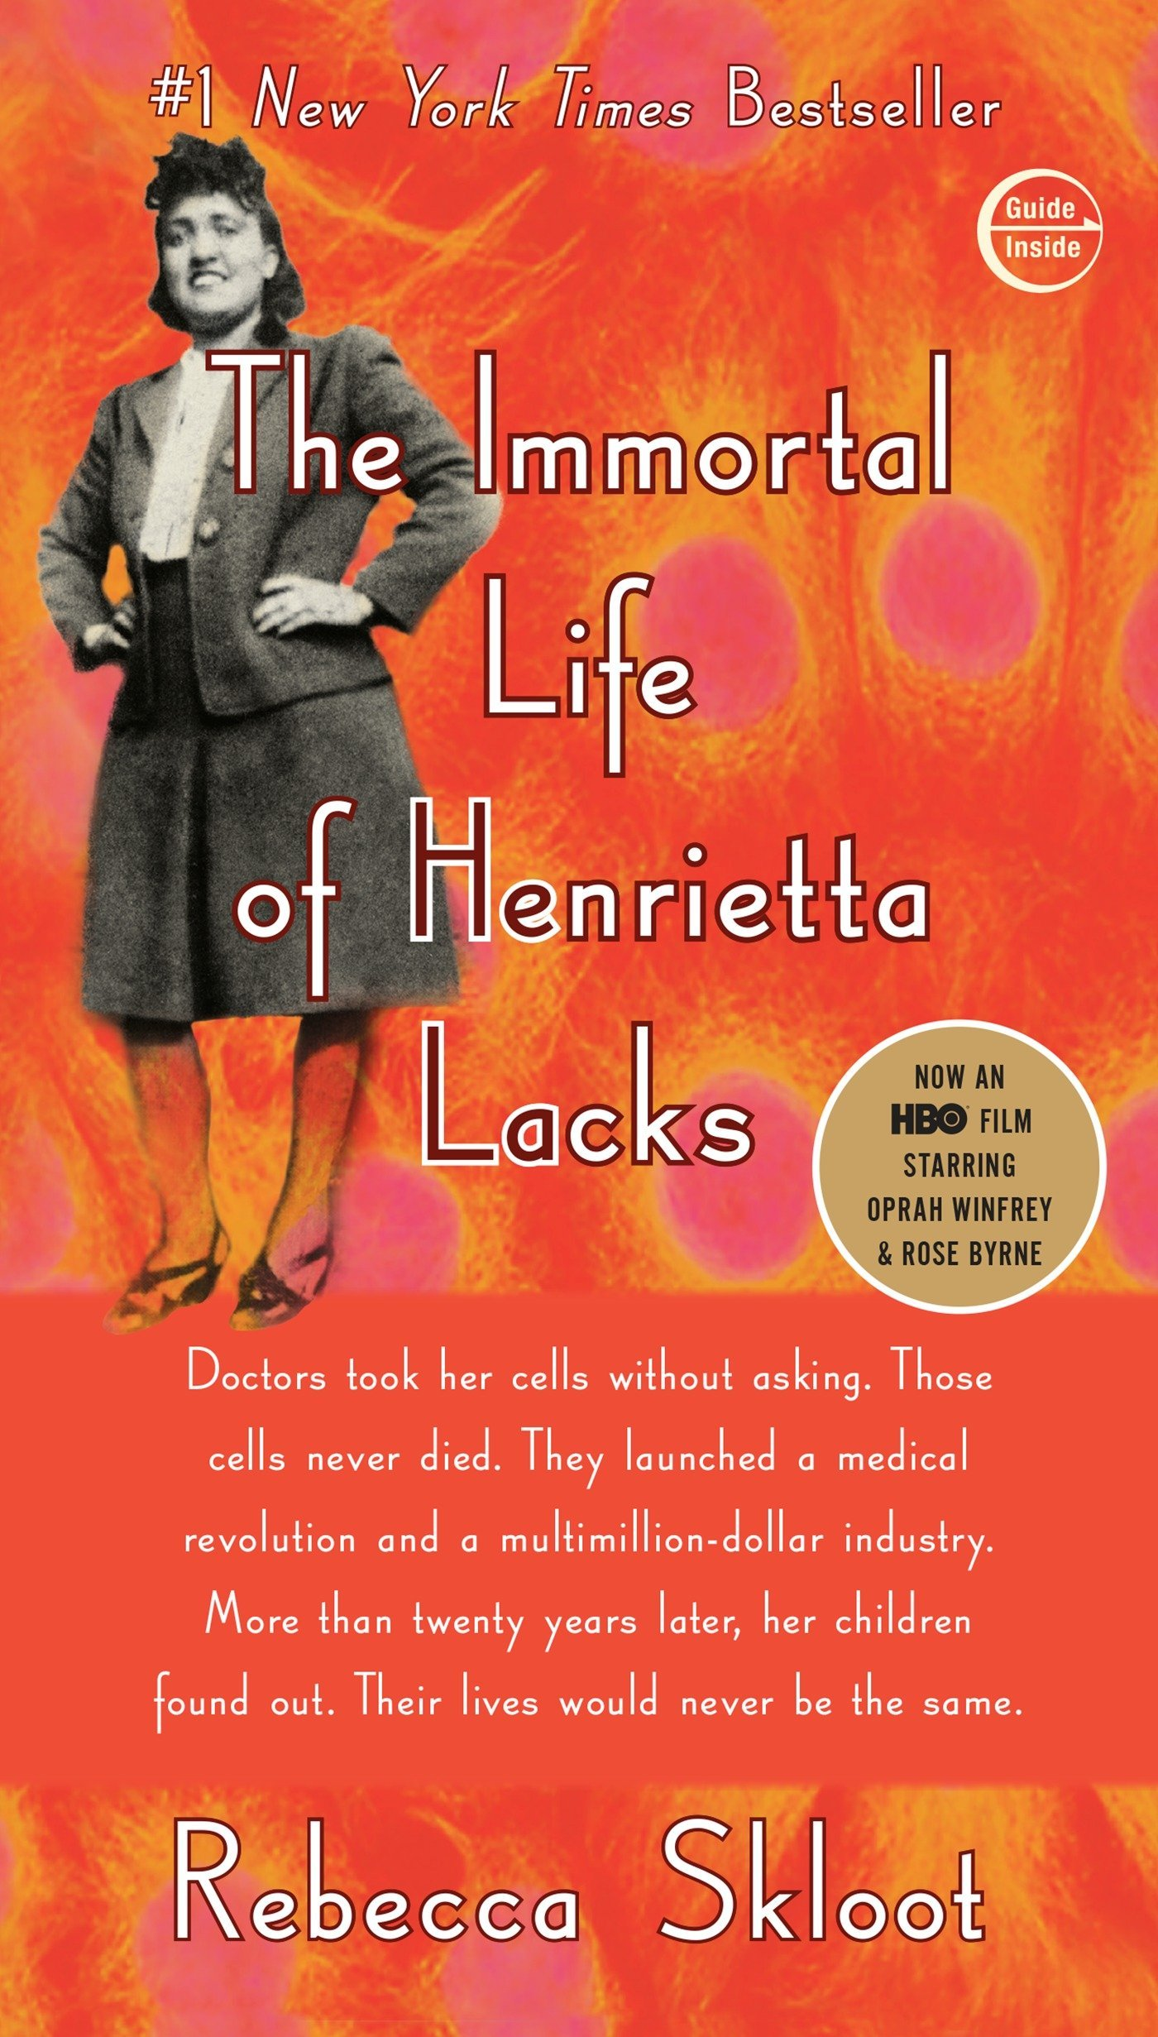
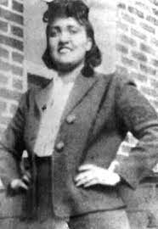
Henrietta Lacks
Henrietta Lacks "HeLa" cells
Poor, black woman in 1951 being treated at John's Hopkins Hospital
Cervical cells were collected during diagnosis and treatment of cancer
First "immortal" cell lines
Polio Vaccine, Cloning, Gene Mapping, In vitro Fertilization, testing human cells in zero gravity space environments, cancer drugs, etc.
Cells were taken before the time of informed consent
Thermo Fisher Scientific being sued by her estate (2021)
Henrietta's family remained in poverty
Notes:
Henrietta Lacks "HeLa" cells
Poor, black woman in 1951 being treated at John's Hopkins Hospital
Cervical cells were collected during diagnosis and treatment of cancer
First "immortal" cell lines
Polio Vaccine, Cloning, Gene Mapping, In vitro Fertilization, testing human cells in zero gravity space environments, cancer drugs, etc.
Cells were taken before the time of informed consent
Thermo Fisher Scientific being sued by her estate (2021)
Thermo Fisher revenue ~35 billion dollars a year
Incomprehensible amount from HeLa cells, which range from $200 to $10,000K a vial
John's Hopkins has not profited
Henrietta's family remained in poverty

Slide 11
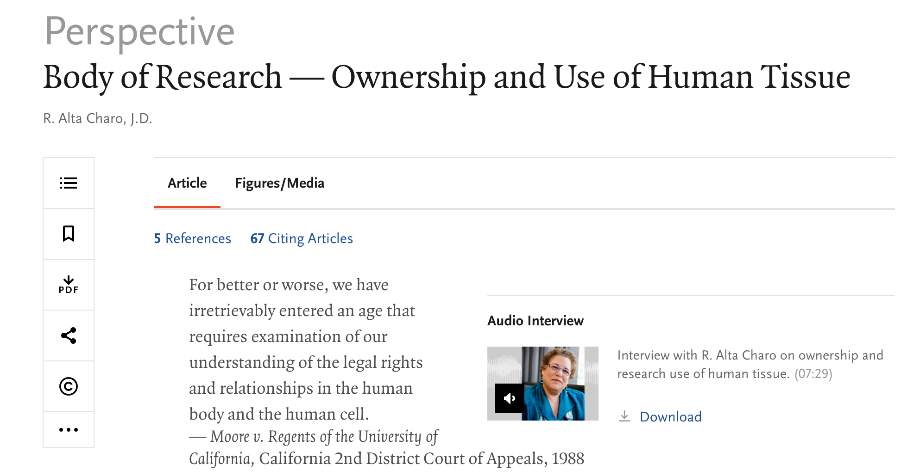
Your Pre-Class Reading
Read the short article on Ownership and Use of Human Tissue before class. Carefully consider the questions presented on your student handout and prepare answers for use in a class-wide debate.
Notes:
Charo, R. A. (2006). Body of research—ownership and use of human tissue. New England journal of medicine, 355(15), 1517-1519.
Read the following short article on Ownership and Use of Human Tissue before class. Carefully consider the questions presented on your student handout and prepare answers for use in a class-wide debate.

Slide 12

Time to debate!

Slide 13
Now... Let's switch side!
If you are well prepared for a debate, you can argue both viewpoints successfully.

